Slide 1
LV DCDC
Bhavin , 1th July 2024

Slide 2
Agenda
Controller
Start-up SW
Main Function
Post Mortem Data
Safety Management Unit
Mcal
Memory Protection Unit
Scheduler
Trap System

Slide 3
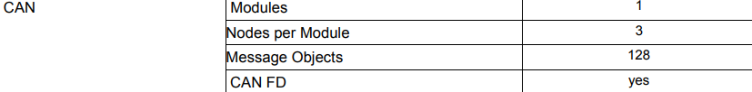
Controller
TC213 SAK-TC213L-8F133F AC
Single Core clocked at 133Mhz
IO Operation Voltage 3.3V, 5V supported in ADC Pins
CAN Module
Memory
P Flash: 0.5Mb
D flash: 64Kb
SRAM : 56KB inc. Cache
Core 0 : DSPR 48KB PSPR 8KB

Slide 4
ADC
2 Independent ADC Modules (12+12 Channels)
12 Channel ADC each i.e. 24 input Lines
Resolution 12Bits
Generic Timer Module
Timer Input Module – Can be used to measure PWM Duty Cycle, Period of incoming PWM
Timer Output Module – 16 Channels to generate PWM
QSPI
4 Queued SPI Interface Channels (QSPI) with master and slave capability up to 50 Mbit/s
PORT –GPIO
Digital programmable I/O ports
Port 00,02,10,11,13,14,15,20,21,22,23,33,34,40,41

Slide 5
Startup SW
First SW executed after a chip reset or Power ON
SSW Start address in BootROM is the reset value of PC register of CPU
SSW is executed -> Last SSW Instruction performs the jump to the first User code Instruction
SSW is provided by Infineon in file IfxCpu_Cstart0.c
We can modify the file according to our use cases

Slide 6
Test Stack, CSA and Cache – Not Used
Clearing all DSPR
Loading User stack Pointer
PSW is set to Default Value
Disabling Program Cache , Data Cache
Initialize the clock system
Loading BTV – Trap Vector Table
Loading BIV – Interrupt Vector Table
Loading ISP
Internal WDG is enabled by default need to disable CPU and Safety WDG at the start-up as they are not used

Slide 7
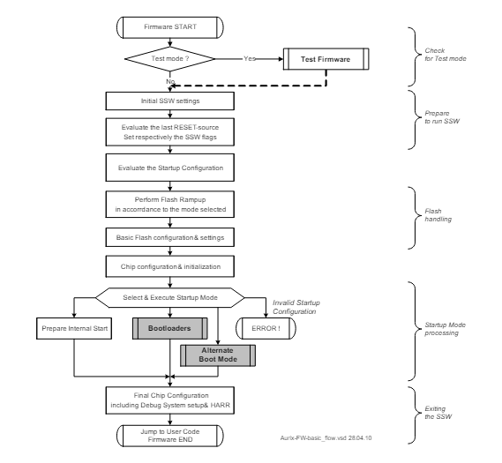

Slide 8
SSW
Core0_main
Start Up initialization of modules
Enables Interrupts
While (1) {
//
}
Return(1);

Slide 9
Main Function
Initializes the PMA data
Microcontroller start-up checks – SMU Check
MCAL Init
Bsw Init
ADC Start-up
HsfbApp_Initialize
Trap Handler Initialisation
Memory Protection (MPU) initialisation
Enable the Interrupts – All the timer interrupts configured during the MCAL init will be called sequentially.
The control will be stuck in while loop and never returns.

Slide 10
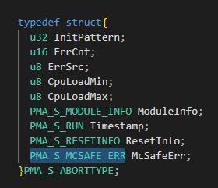
Post Mortem Data
PMA Data is a structure of information about the error source, error count, cpuload, timestamp, reset info, Mcsafe error
It is not stored in LVDC just sent via INTCAN to Com controller during runtime
In Pma_vInit PMA Data is initialised to 0 after the start-up
It also checks for previous shutdown is improper or not . It Reads the status of RSTSTAT Register in SCU

Slide 11
Safety Management Unit
SMU is configured for Alarms and these alarms are used for error detection.
Once an Error is detected appropriate reaction has to take place like a Reset.
SMU Module Consists :
Config : To configure the Alarm and the Alarm Reactions
Static : Code provided by Infineon
In SMU there are 6 Alarm groups and each group have 32 alarms in it
Every alarm has a reason and some configuration through the SW and we can set the reaction for it.
For Each alarm we define a test provided by Infineon
All the Alarm need not to be tested , only the relevant one

Slide 12
Initially at startup McSafeStartUpChecks performs the startup tests
Modules Involved at Startup test:
IOHW
TstHandler
TstM
TstM contains function from Infineon Safety Library
In startup test we inject fault to see whether SMU module is able to detect the error and trigger the Error Reaction
Requirements given in McSafe_SDD in Doors and also check for Infineon Safety Manual

Slide 13
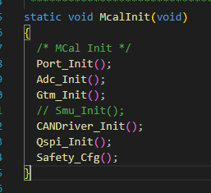
Mcal
Microcontroller Abstraction Layer consist of GPIO,ADC,GTM,CAN,QSPI
Mcal Init is called in main function to initialize all the modules
All these modules are configured by writing to their Control Registers with appropriate value

Slide 14
QSPI
We use the QSPI module in TC213 in order to communicate with TLF SBC which is the external watchdog as well as PMIC
Through SPI we write into the configuration Register of SBC at Initialisation
Window Watchdog timing
Modes of SBC
Initial Configuration
After initialisation during runtime Master Microcontroller monitors certain status registers of SBC
PORT
Information from HSI Document (Hardware Software ). Provides which all pin need to be configured as IN,OUT etc.
Data Sheet need to be used to get the exact control register for each port.pin
External Watchdog (SBC) is serviced by toggling a Pin

Slide 15
GTM (Generic Timer Module)
TOM and TIM are Submodules
GTM - TOM module is used for
Interrupt Source for Scheduler
PWM
CAN Driver
Baud Rate as 500kbps
Out of 3 nodes we are using 1 node
All the configurations are done using the Controller Manual Register Details

Slide 16
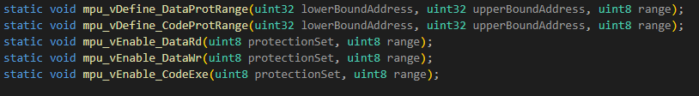
Memory Protection Unit
The protection system incorporates hardware mechanisms that protect user-specified memory ranges from unauthorized read, write, or instruction fetch accesses
Mpu_vInit initializes the Protection set and its access ranges . It is called before enabling the interrupts
Protection set 0 – 3
Protection Ranges
Code Protection Range(0-7)
Data Protection Range(0-15)
Provides control over which regions of memory a task is allowed to access, and what types of access is permitted

Slide 17
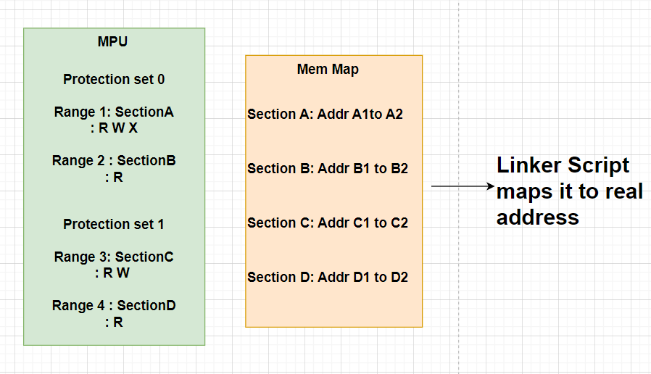

Slide 18
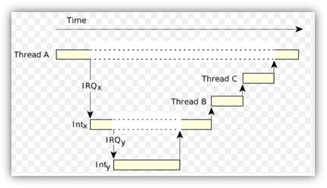

Scheduler
All Tasks are called by the Scheduler module as ISR
4 Interrupt Service Routines of timing 15us, 100us, 1ms, 10ms
Nested Interrupt Mechanism based on Priority
Interrupt handlers configured in Main_isr_cfg.c
Here in the IVT , Higher SRPN <-> Higher Priority
Here there is no OS we directly use the Interrupt system provided by the controller

Slide 19
Access Privilege Level Control (I/O Privilege)
Interrupt Service Routines (ISRs) are dispatched by hardware in response to an interrupt. SMTs are sometimes referred to as user tasks, assuming that they execute in User Mode
Each task is allocated its own mode, depending on the task’s function:
User-0 Mode: Used for tasks that do not access peripheral devices. This mode may not enable or disable interrupts.
User-1 Mode: Used for tasks that access common, unprotected peripherals. Typically this would be a read or write access to serial port, a read access to timer, and most I/O status registers. Tasks in this mode may disable interrupts. (The default behaviour of this mode may be overriden by the system control register).
Supervisor Mode: Permits read/write access to system registers and all peripheral devices. Tasks in this mode may disable interrupts.

Slide 20
Trap
In Trap_vInit all trap handlers are Configured
A trap occurs as a result of an event such as a Non-Maskable Interrupt (NMI), an instruction exception, memory-management exception or an illegal access. Traps are always active; they cannot be disabled by software action.
Trap handlers are configured for different Trap class with its Reaction for each sub Traps like Reset
Eg : Memory Protection Trap
7 Trap class and it has sub traps with TIN
Need to initialize the Trap Vector table (BTV) with its trap handlers

Slide 21
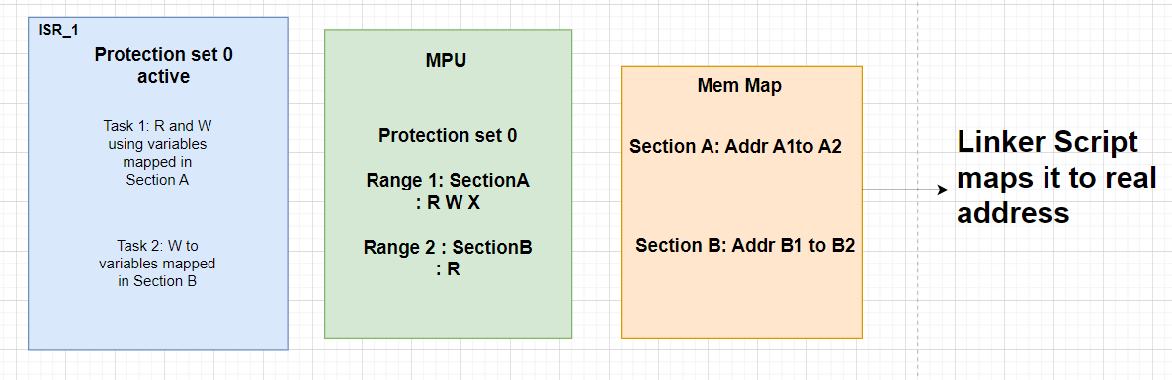

Slide 22
Smarter. Greener. Together.

